Slide 1

Multiple Linear Regression
Dr. Abolfazl Saghafi
Assistant Professor of Statistics
Data Science Program Director
Notes:
In this session we extend the simple linear regression to multiple linear regression

Slide 2
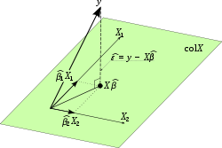
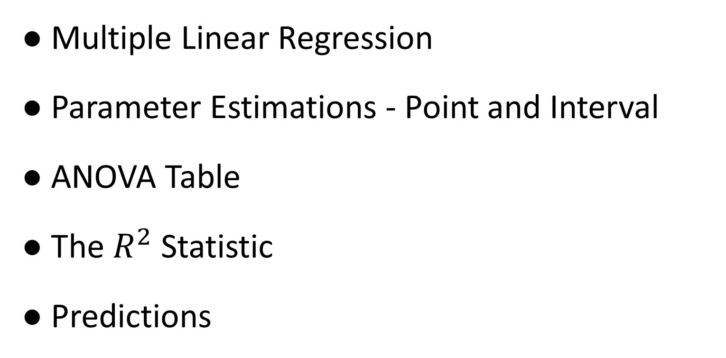
Summary
● Multiple Linear Regression
● Parameter Estimations - Point and Interval
● ANOVA Table
● The $R^{2}$ Statistic
● Predictions
Notes:
In multiple linear regression, we have more than one independent variable in the model, all of which are controlled variables. The dependent variable is still one continuous variable. We are trying to estimate a linear relationship between the one dependent and many independent variables, and we do that using matrix algebra.

Slide 3
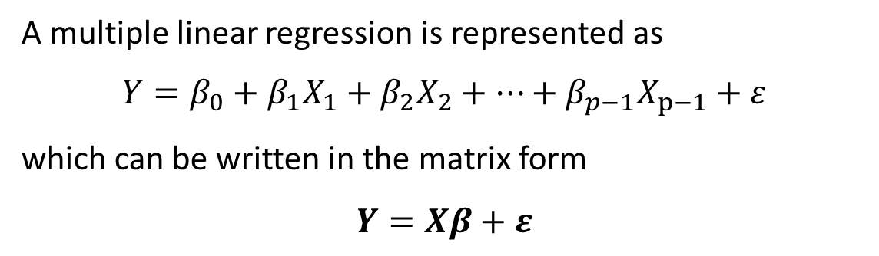
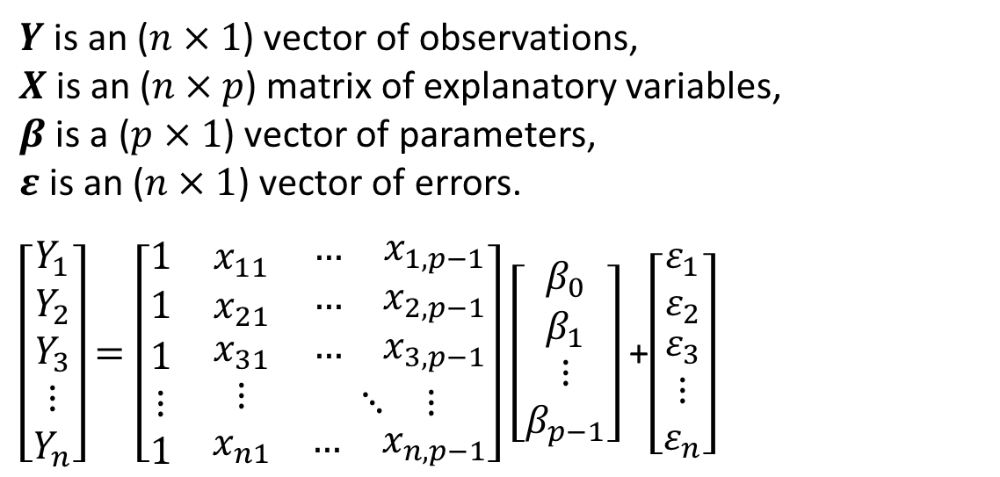
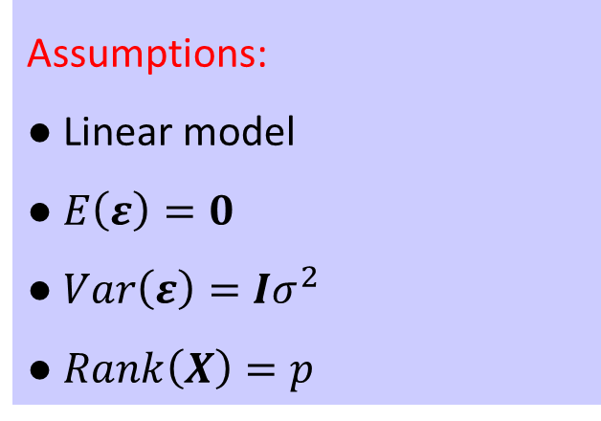
Multiple Linear Regression
Assumptions:
● Linear model
● $E\left(ε\right)=0$
● $Var\left(ε\right)=Iσ^{2}$
● $Rank\left(X\right)=p$
A multiple linear regression is represented as
$$Y=β_{0}+β_{1}X_{1}+β_{2}X_{2}+…+β_{p−1}X_{p−1}+ε$$
which can be written in the matrix form
$$Y=Xβ+ε$$
$Y$ is an ($n×1$) vector of observations,
$X$ is an ($n×p$) matrix of explanatory variables,
$β$ is a ($p×1$) vector of parameters,
$ε$ is an ($n×1$) vector of errors.
$\left[\begin{matrix}Y_{1} \\ Y_{2} \\ \begin{matrix}Y_{3} \\ ⋮ \\ Y_{n}\end{matrix}\end{matrix}\right]$ $=\left[\begin{matrix}1 & x_{11} & \begin{matrix}… & x_{1,p−1}\end{matrix} \\ 1 & x_{21} & \begin{matrix}… & x_{2,p−1}\end{matrix} \\ \begin{matrix}1 \\ ⋮ \\ 1\end{matrix} & \begin{matrix}x_{31} \\ ⋮ \\ x_{n1}\end{matrix} & \begin{matrix}\begin{matrix}… & x_{3,p−1}\end{matrix} \\ \begin{matrix}⋱ & ⋮\end{matrix} \\ \begin{matrix}… & x_{n,p−1}\end{matrix}\end{matrix}\end{matrix}\right]$ $\left[\begin{matrix}β_{0} \\ β_{1} \\ \begin{matrix}⋮ \\ β_{p−1}\end{matrix}\end{matrix}\right]$ +$\left[\begin{matrix}ε_{1} \\ ε_{2} \\ \begin{matrix}ε_{3} \\ ⋮ \\ ε_{n}\end{matrix}\end{matrix}\right]$
Note:
Normality assumption is not required for parameter point estimation.
Notes:
Suppose we have a linear model, a model of the form $Y=β_{0}+β_{1}X_{1}+β_{2}X_{2}+…+β_{p−1}X_{p−1}+ε$. This model can be written as $Y=Xβ+ε$ in a matrix form where $Y$ is an ($n×1$) vector of observations, $X$ is an ($n×p$) matrix of explanatory variables, $β$ is a ($p×1$) vector of parameters, and $ε$ is an ($n×1$) vector of errors. Notice that the first column of X is consists of one, just like we had in the SLR.
The model assumptions are $E\left(ε\right)=0$, $Var\left(ε\right)=Iσ^{2}$, $Rank\left(X\right)=p$ which means columns of X are linearly independent. Notice we don’t have the normality assumption yet. It is not required for parameter point estimation.

Slide 4
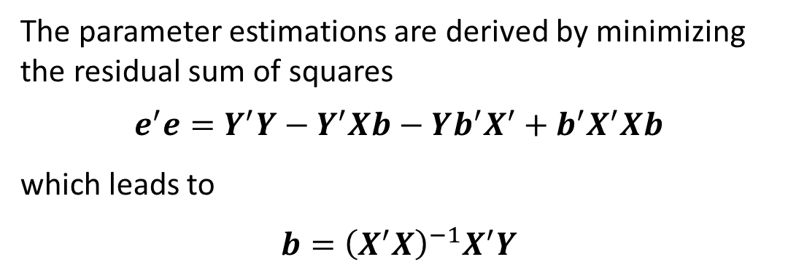
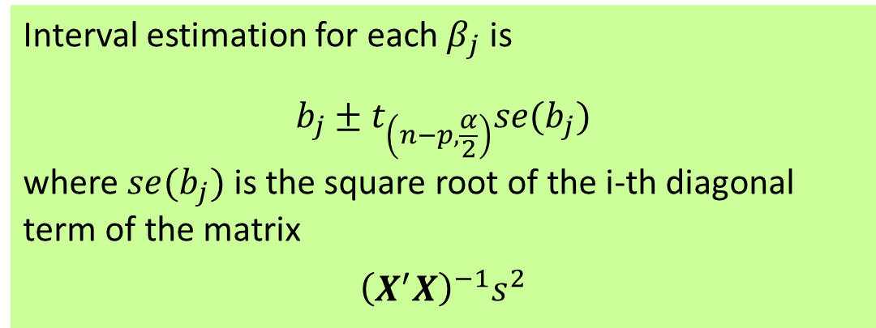
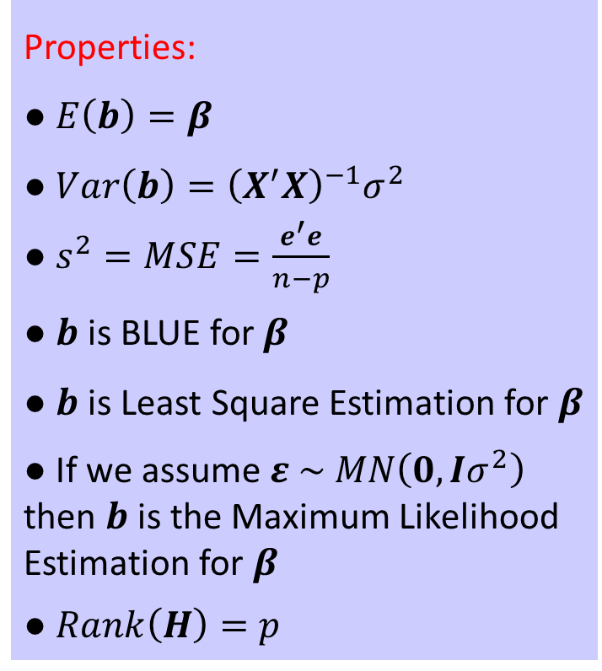
Parameter Point Estimation
Properties:
● $E\left(b\right)=β$
● $Var\left(b\right)={\left(X^{′}X\right)}^{−1}σ^{2}$
● $s^{2}=MSE=\frac{e^{′}e}{n−p}$
● $b$ is BLUE for $β$
● $b$ is Least Square Estimation for $β$
● If we assume $ε \sim MN\left(0,Iσ^{2}\right)$ then $b$ is the Maximum Likelihood Estimation for $β$
● $Rank\left(H\right)=p$
The parameter estimations are derived by minimizing the residual sum of squares
$$e^{′}e=Y^{′}Y−Y^{′}Xb−Yb^{′}X^{′}+b^{′}X^{′}Xb$$
which leads to
$$b={\left(X^{′}X\right)}^{−1}X^{′}Y$$
Interval estimation for each $β_{j}$ is
$$b_{j}±t_{\left(n−p,\frac{α}{2}\right)}se(b_{j})$$
where $se(b_{j})$ is the square root of the i-th diagonal term of the matrix
$${\left(X^{′}X\right)}^{−1}s^{2}$$
Notes:
The parameter estimations are derived by minimizing the residual sum of squares, that is $e^{′}e$, we take derivative of this expression with respect to vector of $b$, it leads to the point estimation given by $b={\left(X^{′}X\right)}^{−1}X^{′}Y$. These estimations are unbiassed, that is $E\left(b\right)=β$. Variance of $b$ equals ${\left(X^{′}X\right)}^{−1}σ^{2}$. The point estimation for $σ^{2}$ is $s^{2}$, that’s the Mean Square Error.
$b$ is BLUE for $β$, that is it has the minimum variance of any linear functions of the observations that provide unbiased estimates for $β$, regardless of the distribution properties of the errors. $b$ is also a Least Square Estimation. If we assume normal distribution for errors, then $b$ is the Maximum Likelihood Estimation for $β$. That is, if we write the Likelihood function and maximize it with respect to parameters, we will get the same $b$ as here.
Interval estimation for each $β_{j}$ can be build using the point estimations, t critical values and standard error of the point estimates.

Slide 5
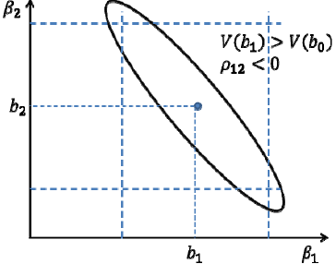
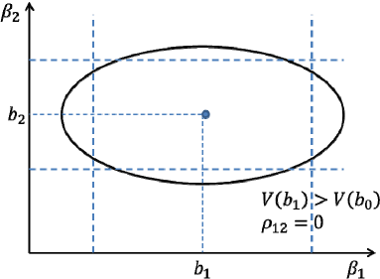
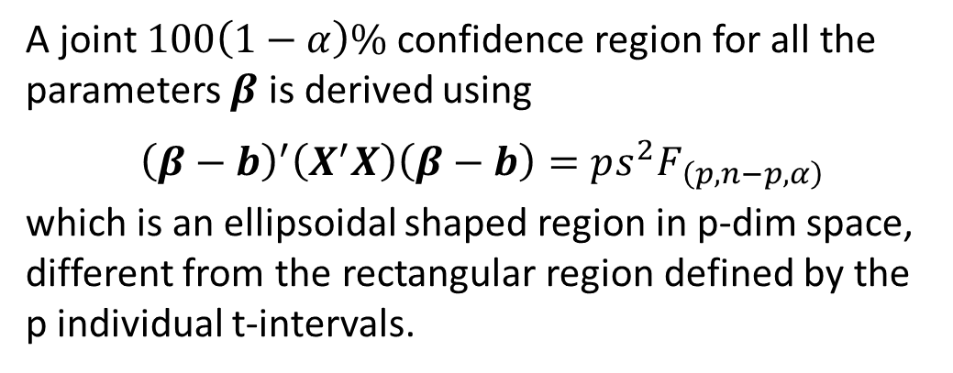
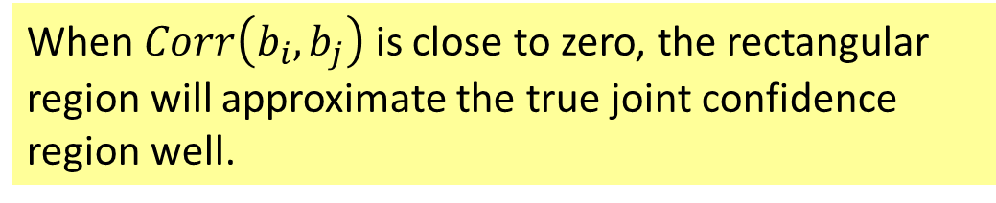
Parameter Interval Estimation
A joint $100\left(1−α\right)\%$ confidence region for all the parameters $β$ is derived using
$${\left(β−b\right)}^{′}\left(X^{′}X\right)\left(β−b\right)=ps^{2}F_{\left(p,n−p,α\right)}$$
which is an ellipsoidal shaped region in p-dim space, different from the rectangular region defined by the p individual t-intervals.
When $Corr\left(b_{i},b_{j}\right)$ is close to zero, the rectangular region will approximate the true joint confidence region well.
Notes:
The intervals we discussed in the previous slide, define a rectangular block in the space of the $β$’s. Look at the graphs for example. If we build confidence intervals for $β_{1}$ and $β_{2}$ separately, the joint area will form a rectangle.
This rectangle is not a proper joint confidence region for the $β$’s. A proper joint interval will be in an ellipsoidal shape which can be build using the given expression.
When $Corr\left(b_{i},b_{j}\right)$ is close to zero, such as the second graph here, the rectangular region will approximate the true joint confidence region well.

Slide 6
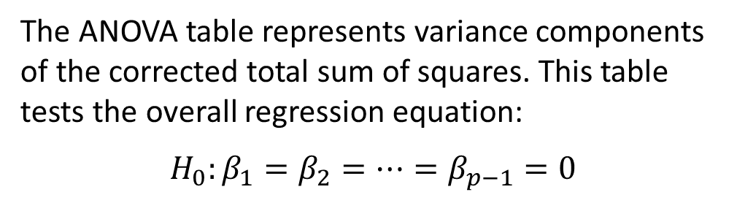
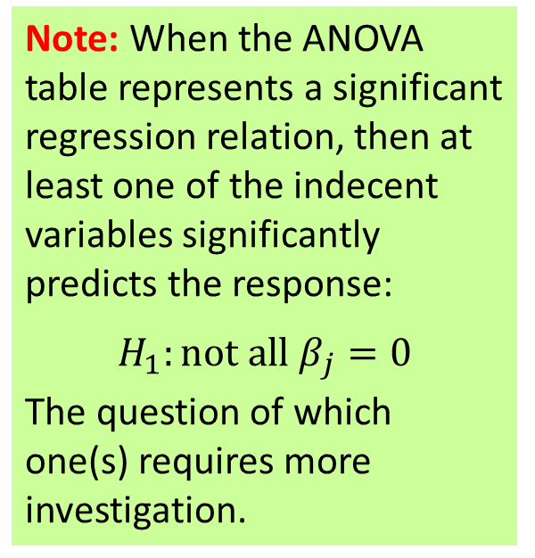
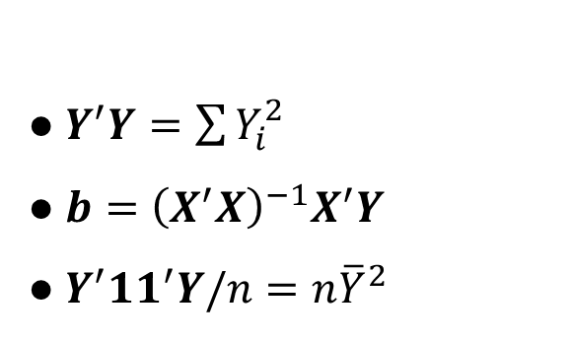
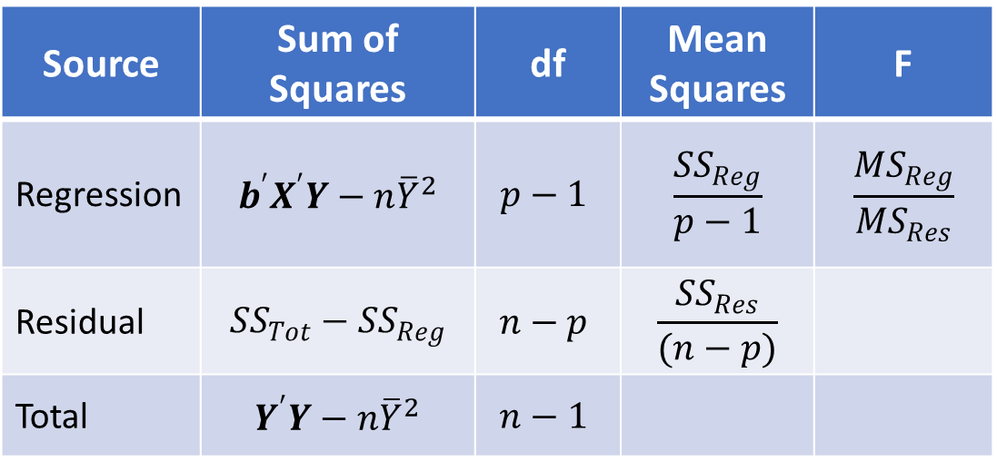
ANOVA Table
● $Y^{′}Y=\sum{Y_{i}^{2}}$
● $b={\left(X^{′}X\right)}^{−1}X^{′}Y$
● $Y^{′}{11}^{′}Y/n=n{\overline{Y}}^{2}$
The ANOVA table represents variance components of the corrected total sum of squares. This table tests the overall regression equation:
$$H_{0}:β_{1}=β_{2}=…=β_{p−1}=0$$
Note: When the ANOVA table represents a significant regression relation, then at least one of the indecent variables significantly predicts the response:
$$H_{1}:not all β_{j}=0$$
The question of which one(s) requires more investigation.
Source | Sum of Squares | df | Mean Squares | F
Regression | $$b^{′}X^{′}Y−n{\overline{Y}}^{2}$$ | $$p−1$$ | $$\frac{{SS}_{Reg}}{p−1}$$ | $$\frac{{MS}_{Reg}}{{MS}_{Res}}$$
Residual | $${SS}_{Tot}−{SS}_{Reg}$$ | $$n−p$$ | $$\frac{{SS}_{Res}}{(n−p)}$$
Total | $$Y^{′}Y−n{\overline{Y}}^{2}$$ | $$n−1$$
Notes:
The ANOVA table in multiple linear regression is the same as the SLR in matrix form. The difference is that, here the F-statistic tests whether all the p-1 parameters $β_{1},β_{2},…,β_{p−1}$ are equal to zero. This is a corrected SS table, that’s why we are testing p-1 parameters, intercept is excluded from testing. The residual Sum Square now has n-p degree of freedom.
It is important to mention that, when the ANOVA table represents a significant regression relation, then at least one of the indecent variables significantly predicts the response, that is al least one of the parameters $β_{j}$ is non-zero. The question of which one(s) requires more investigation.

Slide 7
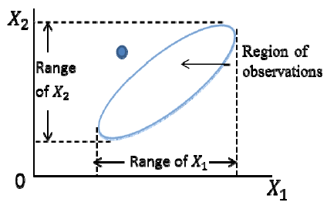
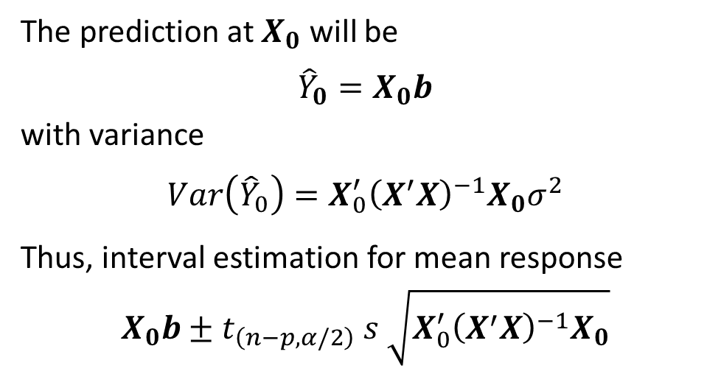
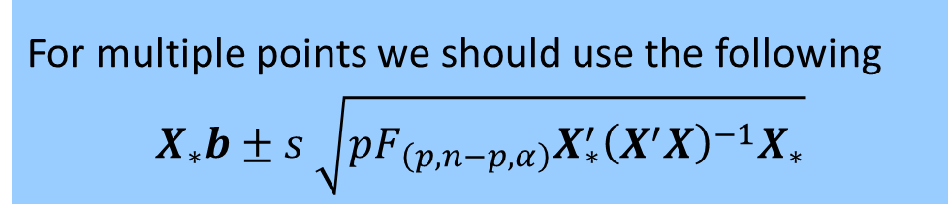
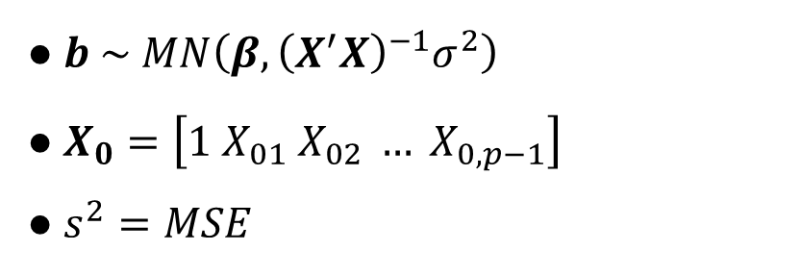
Predictions
● $b \sim MN\left(β,{\left(X^{′}X\right)}^{−1}σ^{2}\right)$
● $X_{0}=\left[1 X_{01} X_{02} … X_{0,p−1}\right]$
● $s^{2}=MSE$
The prediction at $X_{0}$ will be
$${\hat{Y}}_{0}=X_{0}b$$
with variance
$$Var\left({\hat{Y}}_{0}\right)={X_{0}^{′}\left(X^{′}X\right)}^{−1}X_{0}σ^{2}$$
Thus, interval estimation for mean response
$$X_{0}b±t_{\left(n−p,α/2\right)} s \sqrt{{X_{0}^{′}\left(X^{′}X\right)}^{−1}X_{0}}$$
Caution: The model may not be appropriate when estimation or prediction is extended outside of the region of the observations.
For multiple points we should use the following
$$X_{∗}b±s \sqrt{{{pF_{\left(p,n−p,α\right)}X}_{∗}^{′}\left(X^{′}X\right)}^{−1}X_{∗}}$$
Notes:
The prediction at $X_{0}$ are given by $X_{0}b$ that has a variance of ${X_{0}^{′}\left(X^{′}X\right)}^{−1}X_{0}σ^{2}$. Using that, we can build confidence intervals for mean response by the given expression. For multiple points we should use the second formula which creates an oval shape.
It is important to note that the model may not be appropriate when estimation or prediction is extended outside of the region of the observations. That point in the graph is within each X range but overall is outside of the oval shape of the two together and may not be a reliable estimate.

Slide 8
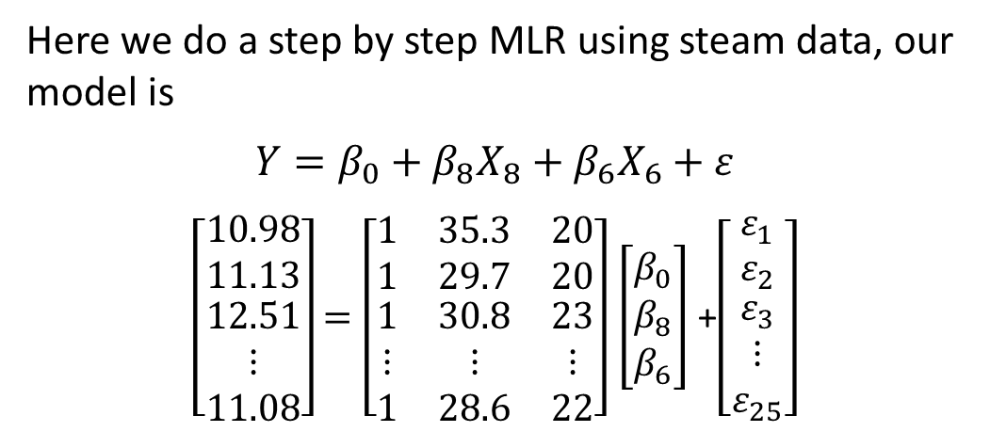
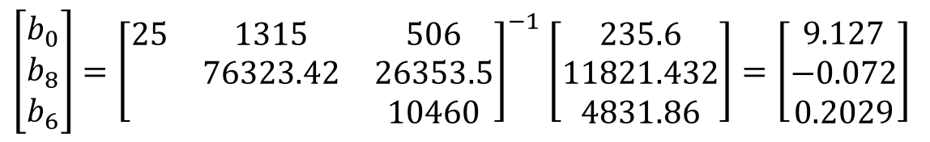
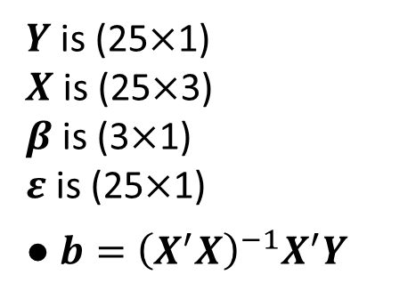
Example
$Y$ is (25$×$1)
$X$ is (25$×$3)
$β$ is (3$×$1)
$ε$ is (25$×$1)
● $b={\left(X^{′}X\right)}^{−1}X^{′}Y$
Here we do a step by step MLR using steam data, our model is
$$Y=β_{0}+β_{8}X_{8}+β_{6}X_{6}+ε$$
$\left[\begin{matrix}10.98 \\ 11.13 \\ \begin{matrix}12.51 \\ ⋮ \\ 11.08\end{matrix}\end{matrix}\right]$ $=\left[\begin{matrix}1 & 35.3 & 20 \\ 1 & 29.7 & 20 \\ \begin{matrix}1 \\ ⋮ \\ 1\end{matrix} & \begin{matrix}30.8 \\ ⋮ \\ 28.6\end{matrix} & \begin{matrix}23 \\ ⋮ \\ 22\end{matrix}\end{matrix}\right]$ $\left[\begin{matrix}β_{0} \\ β_{8} \\ β_{6}\end{matrix}\right]$ +$\left[\begin{matrix}ε_{1} \\ ε_{2} \\ \begin{matrix}ε_{3} \\ ⋮ \\ ε_{25}\end{matrix}\end{matrix}\right]$
$\left[\begin{matrix}b_{0} \\ b_{8} \\ b_{6}\end{matrix}\right]={\left[\begin{matrix}25 & 1315 & 506 \\ & 76323.42 & 26353.5 \\ & & 10460\end{matrix}\right]}^{−1}$ $\left[\begin{matrix}235.6 \\ 11821.432 \\ 4831.86\end{matrix}\right]=\left[\begin{matrix}9.127 \\ −0.072 \\ 0.2029\end{matrix}\right]$
$$\hat{Y}=9.127−0.072X_{8}+0.2029X_{6}$$
Notes:
Now, lets see an example, where we use the steam dataset with two explanatory variable X8 and X6. The linear model is written as $Y=β_{0}+β_{8}X_{8}+β_{6}X_{6}+ε$ which is represented in the matrix form as well.
The parameter estimates can be find using ${\left(X^{′}X\right)}^{−1}X^{′}Y$, using the summary statistic, it will give us these values. Thus, the estimated regression line will be $9.127−0.072X_{8}+0.2029X_{6}$.

Slide 9
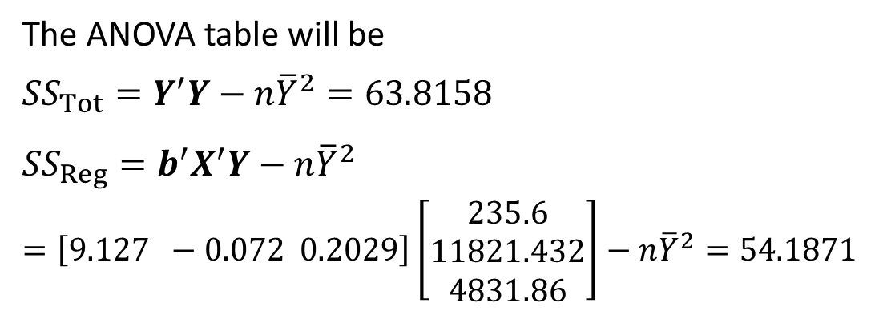

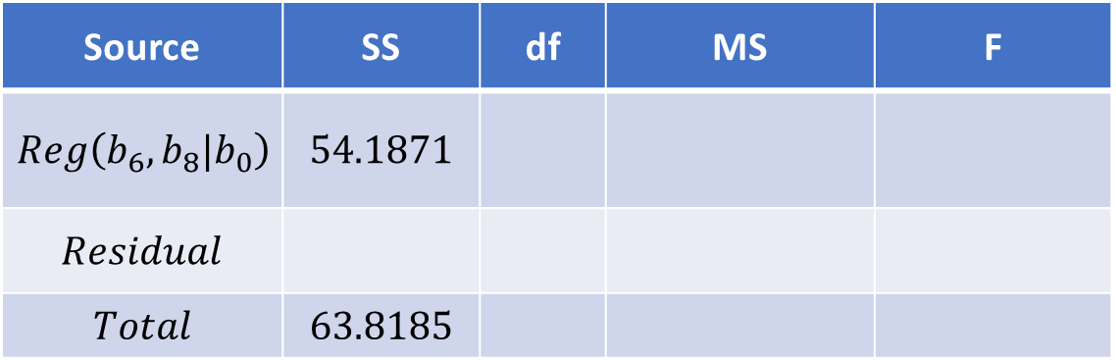
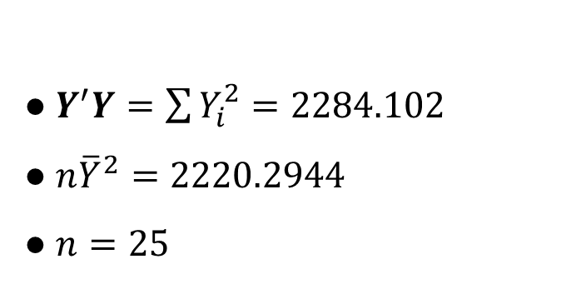
Example
● $Y^{′}Y=\sum{Y_{i}^{2}}=2284.102$
● $n{\overline{Y}}^{2}=2220.2944$
● $n=25$
The ANOVA table will be
$${SS}_{Tot}=Y^{′}Y−n{\overline{Y}}^{2}=63.8158$$
$${SS}_{Reg}=b^{′}X^{′}Y−n{\overline{Y}}^{2}$$
$$=\left[9.127 −0.072 0.2029\right]\left[\begin{matrix}235.6 \\ 11821.432 \\ 4831.86\end{matrix}\right]−n{\overline{Y}}^{2}=54.1871$$
● $R^{2}=$
● $\hat{Var}\left(b\right)={\left(X^{′}X\right)}^{−1}s^{2}$
$$=\left[\begin{matrix} & & \\ & & \\ & & \end{matrix}\right]$$
Source | SS | df | MS | F
$$Reg\left(b_{6},b_{8}|b_{0}\right)$$ | $$54.1871$$
$$Residual$$
$$Total$$ | $$63.8185$$
Notes:
Given the summary statistic, SS Total is computed as $63.82$, and SS Regression will be $54.19$. We have 25 observations, so the degree of freedom for Corrected Total SS is 24. Thus, the Residual SS will be $9.6287$. The degree of freedom for Regression SS will be 2 since there two parameters in the model excluding the intercept. That leaves 22 df for the errors.
MSReg will be 27.0936, MSE will be 0.4377. Therefore, F will be 61.8999 which is a big number and I believe is way greater than the F critical value.
The R-square for this model is 84.89, that is about 85% of the variation in response is explained by X8 and X6.

Slide 10
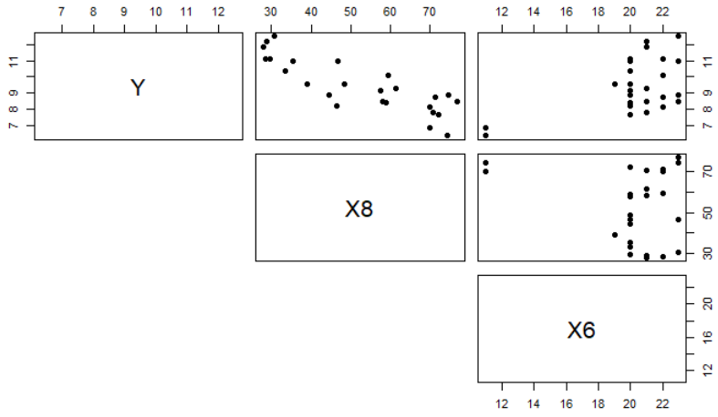
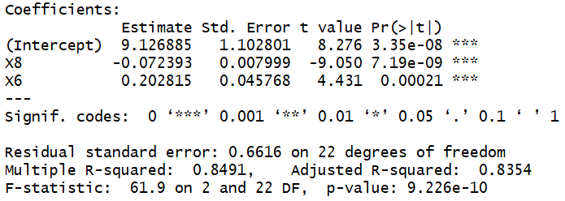
Example / Steam Dataset
We will use Y as response, X8 and X6 as predictors. Starting with a matrix scatterplot, there seems to be linear association between Y and X8, and Y and X6.
Regression results confirms this association. All three parameters are significantly non-zero, evident from individual t-tests.
Regression is also significant meaning that the two coefficients of X8 and X6 are non-zero, evident from F-statistics p-value.
We can also validate these results using direct matrix computations. Codes are provided on Bb.
Notes:
In the matrix scatterplot, Y is always on y-axis.
Follow both the functional codes and matrix computations codes and compare their results

Slide 11
Goodness-of-Fit Measures
Dr. Abolfazl Saghafi
Assistant Professor of Statistics
Data Science Program Director
Notes:
In this session we discuss Goodness of Fit Measures for Multiple Linear Regression Models

Slide 12
Summary
● Adjusted R-square
● Mallow’s Cp
● AIC
● BIC
● PRESS

Slide 13

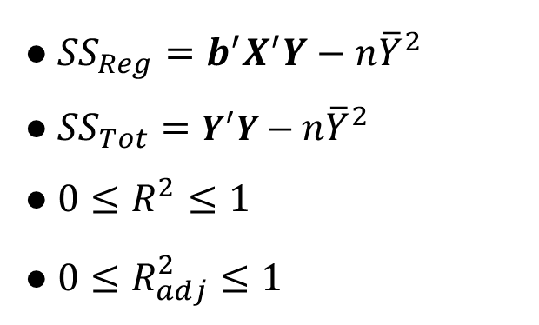
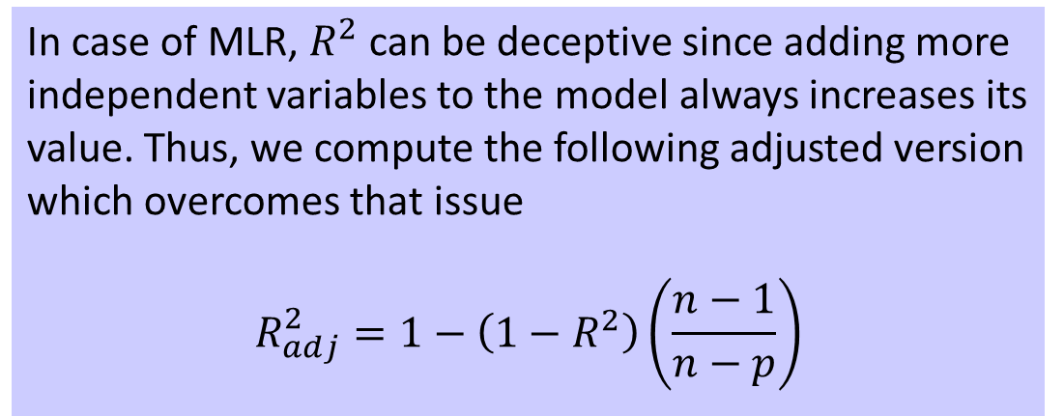
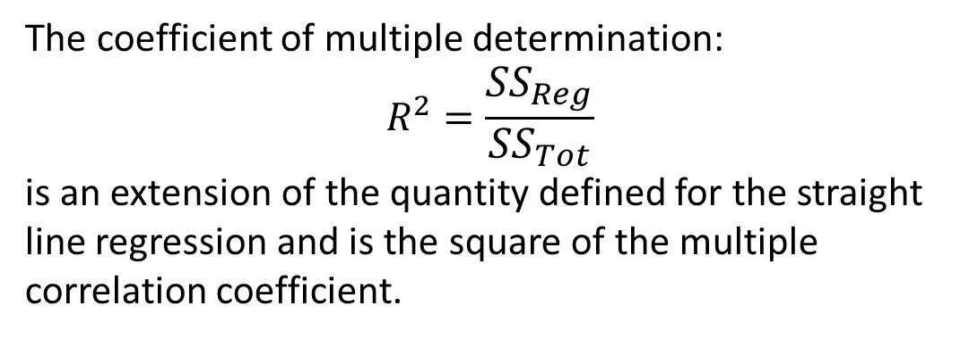
Adjusted $R^{2}$
● ${SS}_{Reg}=b^{′}X^{′}Y−n{\overline{Y}}^{2}$
● ${SS}_{Tot}=Y^{′}Y−n{\overline{Y}}^{2}$
● ${0≤R}^{2}≤1$
● $0≤R_{adj}^{2}≤1$
The coefficient of multiple determination:
$$R^{2}=\frac{{SS}_{Reg}}{{SS}_{Tot}}$$
is an extension of the quantity defined for the straight line regression and is the square of the multiple correlation coefficient.
RMSE is a second Goodness of Fit efficiency measure.
In case of MLR, $R^{2}$can be deceptive since adding more independent variables to the model always increases its value. Thus, we compute the following adjusted version which overcomes that issue
$$R_{adj}^{2}=1−\left(1−R^{2}\right)\left(\frac{n−1}{n−p}\right)$$
Notes:
The coefficient of determination is used as a measure of goodness of Fit defined as $R^{2}=\frac{{SS}_{Reg}}{{SS}_{Tot}}$. $R^{2}$ however, can be deceptive in multiple linear regression, since adding more independent variables to the model, always increases its value. Therefore, we compute the given adjusted version which overcomes this issue. Just like R-square, the adjusted R-square is always between zero and one.

Slide 14
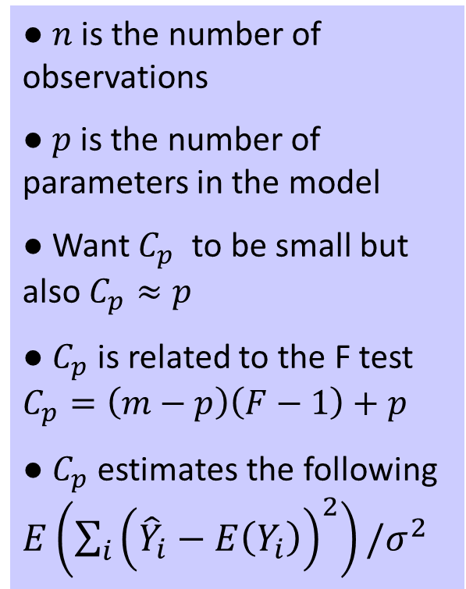
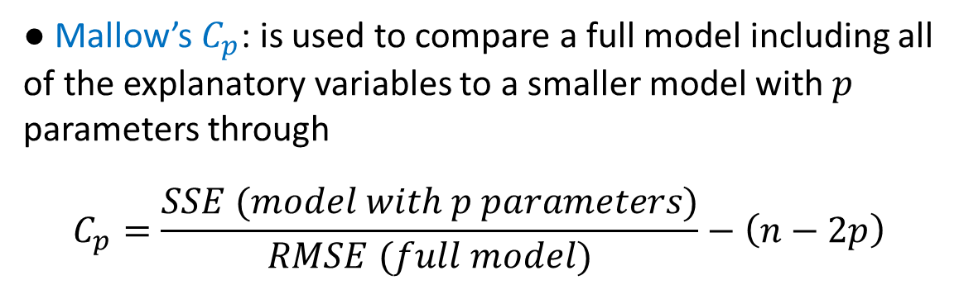
Mallow’s 𝐶p
● $n$ is the number of observations
● $p$ is the number of parameters in the model
● Want $C_{p}$ to be small but also $C_{p}≈p$
● $C_{p}$ is related to the F test $C_{p}=\left(m−p\right)\left(F−1\right)+p$
● $C_{p}$ estimates the following $E\left(\sum_{i}{{\left({\hat{Y}}_{i}−E\left(Y_{i}\right)\right)}^{2}}\right)/σ^{2}$
R-square, Adjusted R-square, and RMSE are well-known Goodness-of-Fit measures that focus on fit only.
The following measures focus on both fit and model complexity, that is they penalize the fit value for complexity.
● Mallow’s $C_{p}$: is used to compare a full model including all of the explanatory variables to a smaller model with $p$ parameters through
$$C_{p}=\frac{SSE (model with p parameters)}{RMSE (full model)}−\left(n−2p\right)$$
Notes:
So far we have introduced three Goodness of Fit measures R-square, Adjusted R-square, and RMSE. These three measures focus on fit only. The following measures focus on both fit and model complexity, that is, they penalize the fit value for complexity.
The first is Mallow’s Cp, it is used to compare a full model including all of the explanatory variables to a smaller model with $p$ parameters through the given expression. We want Cp to be small and close to the number of parameters in the model. Cp is actually related to the F test and estimates the given expected value.

Slide 15
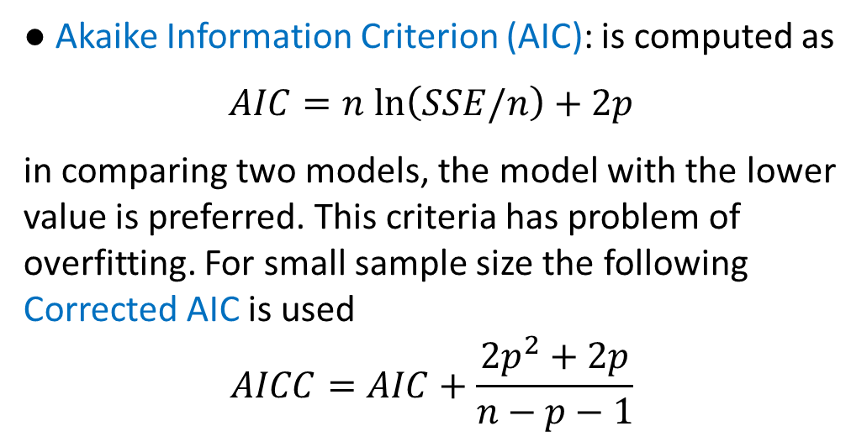
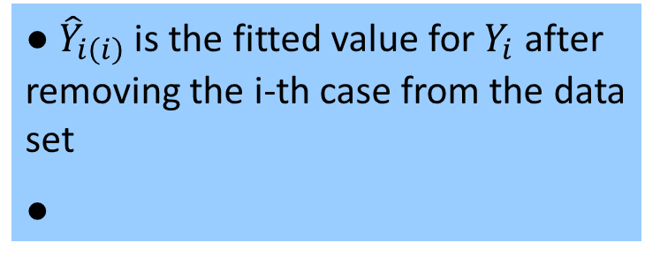
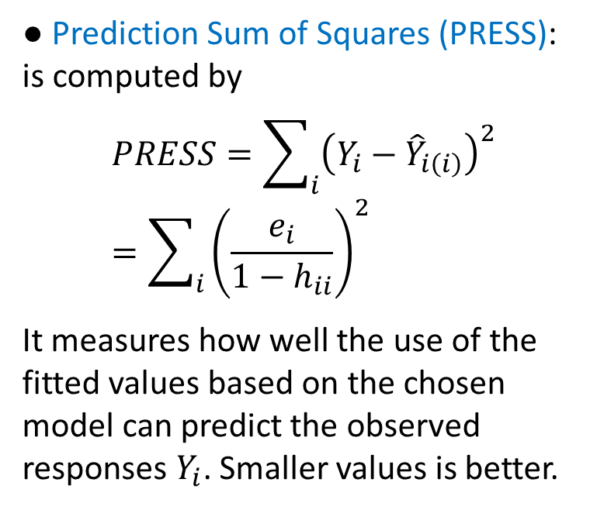
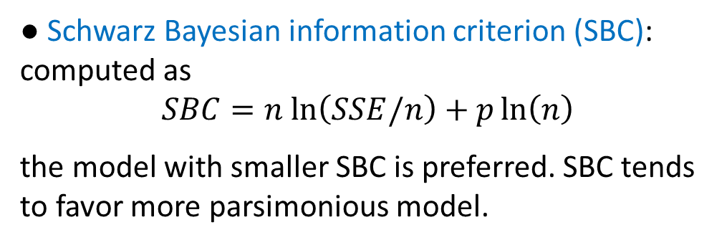
AIC, BIC, PRESS
● Prediction Sum of Squares (PRESS): is computed by
$$PRESS=\sum_{i}{{\left(Y_{i}−{\hat{Y}}_{i\left(i\right)}\right)}^{2}}=\sum_{i}{{\left(\frac{e_{i}}{1−h_{ii}}\right)}^{2}}$$
It measures how well the use of the fitted values based on the chosen model can predict the observed responses $Y_{i}$. Smaller values is better.
● Akaike Information Criterion (AIC): is computed as
$AIC=n ln\left(SSE/n\right)+2p$
in comparing two models, the model with the lower value is preferred. This criteria has problem of overfitting. For small sample size the following Corrected AIC is used
$$AICC=AIC+\frac{2p^{2}+2p}{n−p−1}$$
● Schwarz Bayesian information criterion (SBC): computed as
$$SBC=n ln\left(SSE/n\right)+p\ln\left(n\right)$$
the model with smaller SBC is preferred. SBC tends to favor more parsimonious model.
● ${\hat{Y}}_{i\left(i\right)}$ is the fitted value for $Y_{i}$ after removing the i-th case from the data set
●

Slide 16
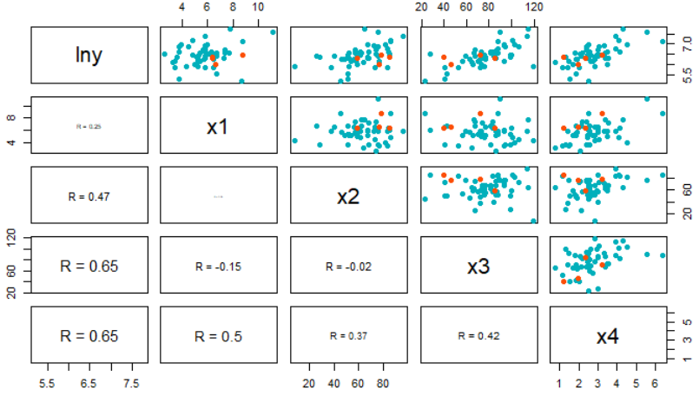
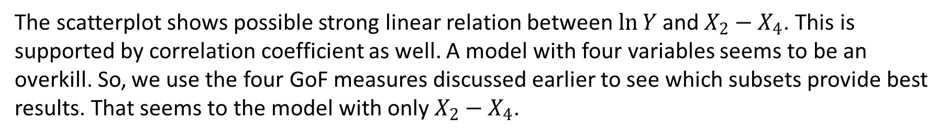
Example
Data shows survival time (Y) in a particular type of live operation. Variables include blood clotting score (X1), prognostic index (X2), enzyme function test score (X3), liver function test score (X4).
The scatterplot shows possible strong linear relation between $\ln{Y}$ and $X_{2}−X_{4}$. This is supported by correlation coefficient as well. A model with four variables seems to be an overkill. So, we use the four GoF measures discussed earlier to see which subsets provide best results. That seems to the model with only $X_{2}−X_{4}$.

Slide 17
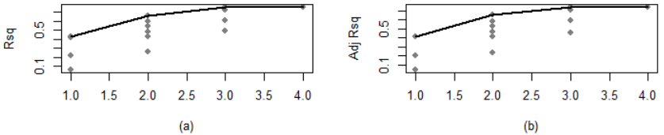
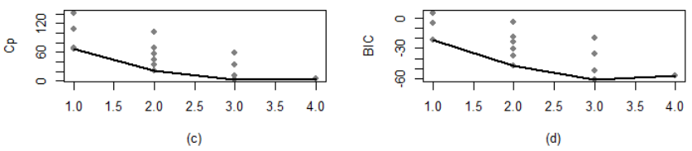
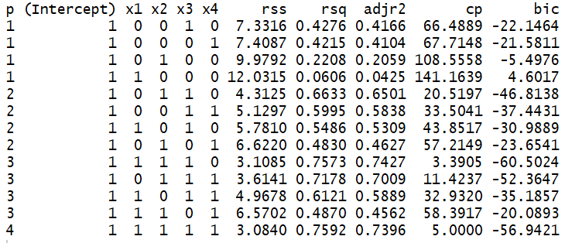
We have charts of four major GoF measures.
The highest Adjusted R-sq is for a full model (0.7592) but a model with X1-X3 achieves 0.7573 which quite close with one variable less.
The minimum Cp is 3.39 which is for a model with 4 parameters, 3.39 is close to 4 and this makes it a great model (the one with X1-X3).
BIC for this model is also minimum, so the choice is simple.
Notes:
You might be asking what happened to X4, it had a better linear relationship with lnY afterall. We will discuss later on reasons why removing some initially good variables can actually improve a fit.

Slide 18
Outliers and Influential Cases
Dr. Abolfazl Saghafi
Assistant Professor of Statistics
Data Science Program Director
Notes:
In this session we discuss more techniques for residual analysis

Slide 19
Summary
Individual cases can be
● Outliers in $Y$ - detected as usual in a single sample
● Outliers in $X$ - high leverage and influential cases
● Regression outliers - outliers in $Y$ for a given $X$
● Hat Matrix
● Regression Outliers
● Outliers in 𝑋
● Influential Cases
● Added Variable Plot
● Partial Plots
Bodyfat Dataset: 20 samples of healthy females 25-34 years old on
Body fat ($Y$)
Triceps skinfold thickness ($X_{1}$)
Thigh circumference ($X_{2}$)
Notes:
We have already discussed the basic residuals plots and the Durbin-Watson test for serial correlation. In many regression problems, these checks are perfectly adequate. Here we discuss outliers and further techniques that are of great value.
Individual cases can be outliers in $Y$ which are detected as usual in a single sample, observations out of the overall pattern. They can be outliers in $X$ could be high leverage and influential cases, or regression outliers that is outliers in $Y$ for a given $X$.

Slide 20
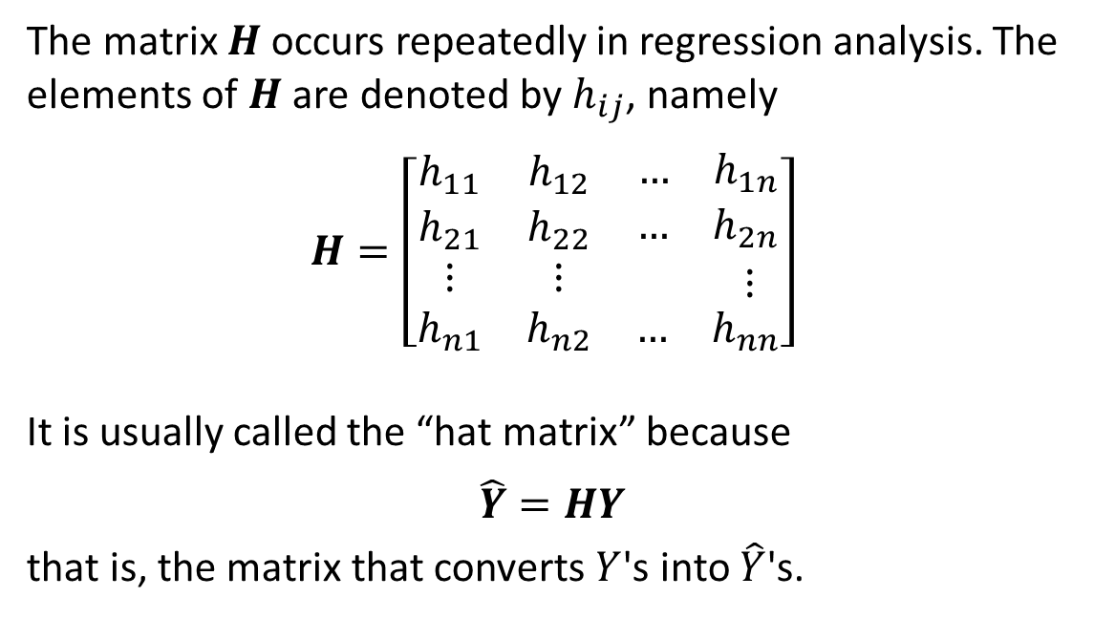
Hat Matrix
Properties:
● $n$ is the number of observations
● ${H=X\left(X^{′}X\right)}^{−1}X^{′}$
● $H^{′}=H$
● $H^{2}=H$
● ${(I−H)}^{2}=(I−H)$
● $H1=1$ that is, every row adds up to 1. So does every column since H is symmetric.
● $0≤h_{ii}≤1$
● $\sum_{i=1}^{n}{h_{ii}}=p$
● $Rank\left(H\right)=p=Rank\left(X\right)$
The matrix $H$ occurs repeatedly in regression analysis. The elements of $H$ are denoted by $h_{ij}$, namely
$$H=\left[\begin{matrix}h_{11} & h_{12} & \begin{matrix}… & h_{1n}\end{matrix} \\ h_{21} & h_{22} & \begin{matrix}… & h_{2n}\end{matrix} \\ \begin{matrix}⋮ \\ h_{n1}\end{matrix} & \begin{matrix}⋮ \\ h_{n2}\end{matrix} & \begin{matrix}\begin{matrix} & ⋮\end{matrix} \\ \begin{matrix}… & h_{nn}\end{matrix}\end{matrix}\end{matrix}\right]$$
It is usually called the “hat matrix” because
$$\hat{Y}=HY$$
that is, the matrix that converts $Y$'s into $\hat{Y}$'s.
Notes:
Frist let’s go over the hat matrix which plays an important role in regression analysis. This matrix $H$ occurs repeatedly in regression. The elements of $H$ are shown by $h_{ij}$, in a matrix formation, the matrix is n by n, where n is the number of observations. This matrix is usually called the “hat matrix” because $\hat{Y}=HY$, that is, the matrix that converts $Y$'s into $\hat{Y}$'s.
It is defined as ${X\left(X^{′}X\right)}^{−1}X^{′}$, it’s a symmetric, idempotent matrix, $I−H$ is also idempotent, summation of values in every row and every column of this matrix is equal to 1, the main diagonal components of the matrix are positive and add up to p, which is the rank of the matrix.

Slide 21
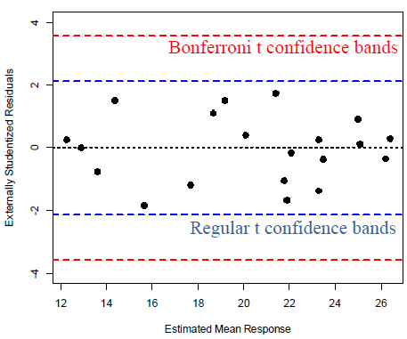
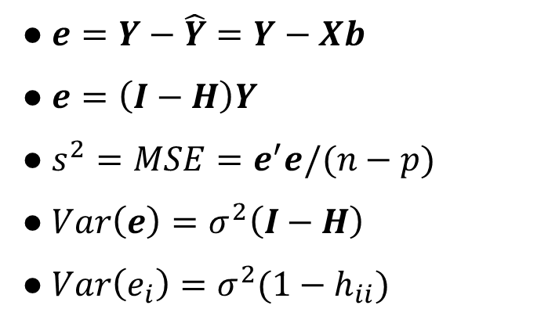
Regression Outliers
● $e=Y−\hat{Y}=Y−Xb$
● $e=\left(I−H\right)Y$
● $s^{2}=MSE=e^{′}e/(n−p)$
● $Var\left(e\right)=σ^{2}\left(I−H\right)$
● $Var\left(e_{i}\right)=σ^{2}(1−h_{ii})$
● Internally studentized residuals
$$s_{i}=\frac{e_{i}}{s\sqrt{1−h_{ii}}}$$
$s_{i}$have zero mean and approximately equal variance when the model is appropriate. Any observation in which $\left|s_{i}\right|>\sqrt{n−p}$, triggers an outlier. Outliers will inflate MSE.
● $s^{2}\left(i\right)=\frac{\left(n−p\right)s^{2}−e_{i}^{2}/(1−h_{ii})}{n−p−1}$
is an estimate of $σ^{2}$ without case $i$
● Externally studentized residuals
$$t_{i}=\frac{e_{i}}{s(i)\sqrt{1−h_{ii}}}$$
Test a single outlier by comparing $t_{i}$ to $t_{n−p−1}$ distribution. Use Bonferroni multiple comparison procedure by
comparing $\left|t_{i}\right|$ to $t_{n−p−1,α/2n}$ which provides a very
conservative test to detect multiple outliers.
Notes:
Residuals are used in a number of ways to detect regression outliers. Internally studentized residuals can be computed using this expression, that is, by dividing each residual by its standard error. The standard error for the i-th observation can be find by looking at the i-th diagonal component of matrix $\left(I−H\right)$ and multiplying that by RMSE.
$s_{i}$have zero mean and approximately equal variance when the model is appropriate. Any observation in which $\left|s_{i}\right|>\sqrt{n−p}$, triggers an outlier. Outliers will inflate MSE and cause wider prediction intervals.
Externally studentized residuals are computed using ti, which is the same thing as si BUT MSE is computed after removing the i-th observation. The ti follow a t(n-p-1) distribution under the usual normality of errors assumption. Therefore, we test a single outlier by comparing its $t_{i}$ to $t_{n−p−1}$ critical value. We use Bonferroni multiple comparison procedure by comparing multiple $\left|t_{i}\right|$ to $t_{n−p−1,α/2n}$ which is a very conservative test to detect multiple outliers.
The graph here shows plot of Externally studentized residuals for body fat dataset, and you can see that all observations are within the regular t and Bonferroni t confidence bounds.

Slide 22
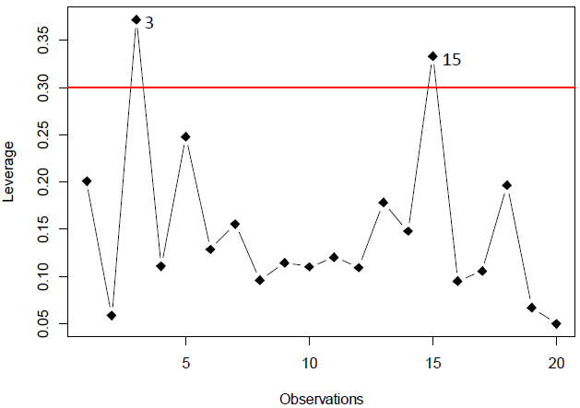
Outliers in $X$
Application:
● Use $2p/n$ as a guide to determine high-leverage cases
● Look for high $h_{ii}$ by examining the distribution of $h_{ii}$ values across cases
● Examine the scatterplot and find cases that are far from the cluster
● Leverage
The diagonal elements of $H$ are often called the leverages, since examination of
$${\hat{Y}}_{i}=h_{ii}Y_{i}+\sum_{j≠i}{h_{ij}Y_{j}}$$
indicates via $h_{ii}$ how heavily $Y_{i}$ contributes to ${\hat{Y}}_{i}$.
High-leverage points are outliers in the X-space but the converse is not necessarily true.
The graph shows the leverage plot for Body Fat example with 20 observations. The cutoff point is $2p/n=2∗3/20=0.3$
Notes:
The diagonal elements of $H$ are often called the leverages, since $h_{ii}$, the i-th component in the diagonal of H, shows how heavily observation i contributes its prediction. High-leverage points are outliers in the X-space but the converse is not necessarily true.
This is how they are applied, we use the bound $2p/n$ as a guide to determine high-leverage cases, p here is the number of parameters in the model including the intercept and n is the number of observations. So, we look for high $h_{ii}$ by examining the distribution of $h_{ii}$ values across cases. We can also examine the scatterplot of data and find cases that are far from the cluster, as we did before.
The graph shows the leverage plot for Body Fat dataset with 20 observations. The cutoff point is $2p/n=2∗3/20=0.3$ and you can see that observation number 3 and 15 have high leverage.

Slide 23
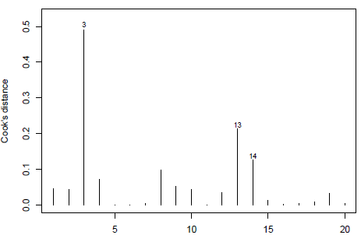
Influential Cases
● $p$ is the number of parameters in the model including the intercept
● $h_{ii}$ is the i-th component of hat matrix
● $s^{2}$ is the MSE
● Cook’s Distance
$$D_{i}=\frac{e_{i}^{2}}{ps^{2}}\left[\frac{h_{ii}}{{\left(1−h_{ii}\right)}^{2}}\right]$$
measures the (aggregate) influence of the i-th case on the fitted values for all cases, which is equivalent to measuring effect on estimates of $β$.
$D_{i}<F_{\left(p,n−p,0.8\right)}$ is no concern (20th percentile).
$D_{i}>F_{\left(p,n−p,0.5\right)}$ indicates substantial influence.
In the Body fat example
$$F_{\left(p,n−p,0.8\right)}=F_{\left(3,17,0.8\right)}=0.34$$
$$F_{\left(p,n−p,0.5\right)}=F_{\left(3,17,0.5\right)}=0.82$$
Notes:
There are some measures that help detecting influential cases, one is Cook’s distance, given by this expression. This distance measures the influence of the i-th case on the fitted values for all cases, which is equivalent to measuring effect on estimates of $β$. For any observation, if $D_{i}<F_{\left(p,n−p,0.8\right)}$, that is the 20th percentile of the F distribution, then the observation is fine. But if $D_{i}>F_{\left(p,n−p,0.5\right)}$, the 50th percentile, then the case i is substantially influential.
This graph represent Cook’s distance for the body fat example. The 20th and 50th percentiles are 0.34 and 0.82 respectively, so there are no substantially influential cases, however, observation number 3 is influential.

Slide 24
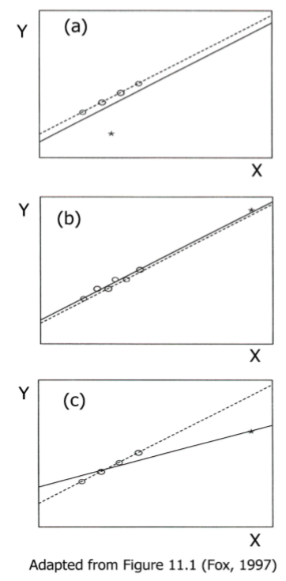
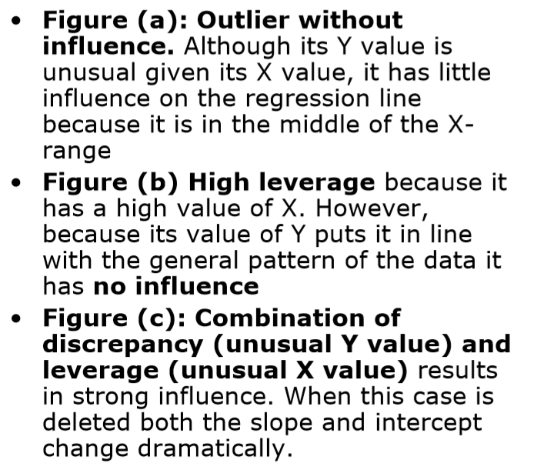
Outlier/Influential/High Leverage

Slide 25



Example
20 samples of healthy females 25-34 years old on Body fat ($Y$), Triceps skinfold thickness ($X_{1}$), Thigh circumference ($X_{2}$).
The scatterplot shows possible association between Y and X1, X2. Both variables seem to significantly contribute to the response.
The fit is seems to be near perfect as well. Before finalizing the model, we need to investigate the residuals.

Slide 26



The outlier and Leverage plot detects two high leverage (#15, #3) cases. No outliers is detected by internally or externally studentized residuals.
Looking at Cook’s distance charts shows that #3 is an influential observation. Therefore, we should remove #3 and refit the model, then investigate everything again.
Notes:
Once we investigate the refitted model, the scatterplot reveals that initial outlier is removed. Everything else seems ok so the second model with 19 observations are preferred.

Slide 27

Example – Birthwt Dataset
Birth Weight Dataset of 100 cases on
momage Mother’s age in years
gestage Gestational age in years
length Length at birth in cm
headcirc Head Circumference in mm
birthwt Birth Weight in Grams (dep.)
Looking at the generate graphs we can see that observations number 9, 31, and 57 are extreme outliers. Number 89 and 96 are also marked outliers and I decide to remove 89 but keep 96.
Number 33 and 56 are marked high leverage observations. I first delete the outliers and repeat the analysis, then delete the leverage observations and repeat the analysis. If the change was significant remove them from modeling.
Notes:
Codes are provided in handouts

Slide 28



The removal of #9, #31, #57 are also supported by Cook’s D graph. The regression fit increases significantly after removing the four detected outliers.
Let’s see how things change after removing #33, #56, and #98 (new outlier).
The Adjusted R-square is now 0.87 with RMSE of 96. This better than the first model but still there might be ways to improve the fit. You have to be patient and investigative and run various versions to come up with a good model.

Slide 29
Gradient Descent
Dr. Abolfazl Saghafi
Assistant Professor of Statistics
Data Science Program Director
Notes:
So far we learned how to find the parameter estimates for multiple linear regressions directly using normal equations. In this session we learn how to find the estimations using recursive numerical methods.

Slide 30

Summary
● Gradient Descent
● Learning Rate
● Example
● MLR
● Examples
Notes:
Gradient Descent is a common numerical method that finds parameter estimates by recursively minimizing the cost function.

Slide 31



Gradient Descent
Assumptions:
● Multiple linear regression model
$$Y=Xβ+ε$$
● Parameter estimates are
$$b=X{\left(X^{′}X\right)}^{−1}X^{′}$$
● To minimize the cost function, set initial values $\left(b_{0}^{0},b_{1}^{0},…,b_{p−1}^{0}\right)$ and update them recursively
● $α$ is the learning rate
● Stopping criteria could be the number of steps or reaching predefined improvement in the cost.
Imagine we have a high-dimensional cloud of data points represented by matrix $X$. Storing a dense $X^{′}X$ matrix would require HUGE floating point numbers. Computing its inverse is SUPER Time consuming. Fortunately, we have an iterative method to estimate the regression parameters without computing $inv\left(X^{′}X\right)$, which is the gradient descent method.
To minimize the average cost
$$J\left(β\right)=\frac{1}{2n}\sum_{i=1}^{n}{{\left(y^{\left(i\right)}−{\hat{y}}^{\left(i\right)}\right)}^{2}}$$
Gradient Descent starts by a vector of initial values for the parameters, $b^{0}$, then updates them using the following until some stopping criteria is met
$$b_{j}^{k}≔b_{j}^{k−1}−α\frac{1}{n}\sum_{i=1}^{n}{\left(y^{\left(i\right)}−{\hat{y}}^{\left(i\right)}\right)x_{j}^{\left(i\right)}}$$

Slide 32

Learning rate
If your learning rate is set too low, updating parameters will progress very slowly as you are making very tiny updates to the weights.
However, if your learning rate is set too high, it can cause undesirable divergent behavior in your loss function.
The learning rate (α) in gradient descent scales the magnitude of our weight updates in order to minimize the cost loss function.

Slide 33



Contour Plots
Notes:
● Gradient Descent ensures converges, albeit to a local minimum.
● Gradient descent makes a monotonic improvement at every iteration.
● Introducing an iterative way to update the learning rate could help with convergence speed at the cost of complexity.
● https://distill.pub/2017/momentum/
Contour plots are used, to visualize the upgrade path in the parameters when we have more than two predictor.

Slide 34



Example – Profit Data
We have data for profits (y) of a restaurant franchise and populations (x) from different cities. The aim is to find fit a linear regression to data and use it to predict future profit based on a city's population. For fitting we use gradient descent method.
Starting off with $\left(0,0\right)$ as initial states for the two parameters in the model, you can see how the cost decreased to a stable point by iteration 1500.

Slide 35



The results using gradient descent reveals the estimations as $\left(b_{0},b_{1}\right)=(−3.630291,1.166362)$. The minimum cost achieved at iteration 1500 is 4.483388.
Estimated parameters using direct computations gives out $\left(b_{0},b_{1}\right)=(−3.89578,1.19303)$.
MSE/2 for this model is 4.476971 which is the value that numerical methods should eventually converge to.

Slide 36


Example – Price Data
The price data contains a set of housing prices in Portland, Oregon. The first column (x1) is the size of the house (in square feet), the second column (x2) is the number of bedrooms, and the third column (y) is the price of the house.
The 3D plot shows the scatterplot of data along with the multiple linear regression plain derived using R build-in “lm” function.
The summary of fit shows estimated parameters and GoF measures. Now, lets try a gradient descent method and compare results.

Slide 37


The gradient descent method with 500 iterations converges to the following model parameters
Int. 340412.660
x1 110631.050
x2 -6649.474
You can see that the convergence speed depends on the learning rate.
The minimum cost achieved at iteration 1500 is 2,043,280,051. The RMSE for this model is 63926.21
The model using direct matrix computations achieves minimum average cost of 2,182,622,450 with RMSE of 66070! The difference is due to matrix inverse computations with big inputs. Standardization helps with such issues.

Slide 38
Help
Gradient Descent Example:
https://www.r-bloggers.com/linear-regression-by-gradient-descent/
Awesome Explanation on Gradient Descent
https://distill.pub/2017/momentum/

